Slide 1
Data Analytics process (Application in real life scenario – Case Study)
PROJECT_1
Prepared By
Vaishnavi Patel

Slide 2
Few examples of daily task where data science can be applied: Let’s see “How data analysis can be applied for Meal preparation”.
1. Meal preparation 2. Grocery shopping 3. Fitness tracking 4. Personal finance management

Slide 3




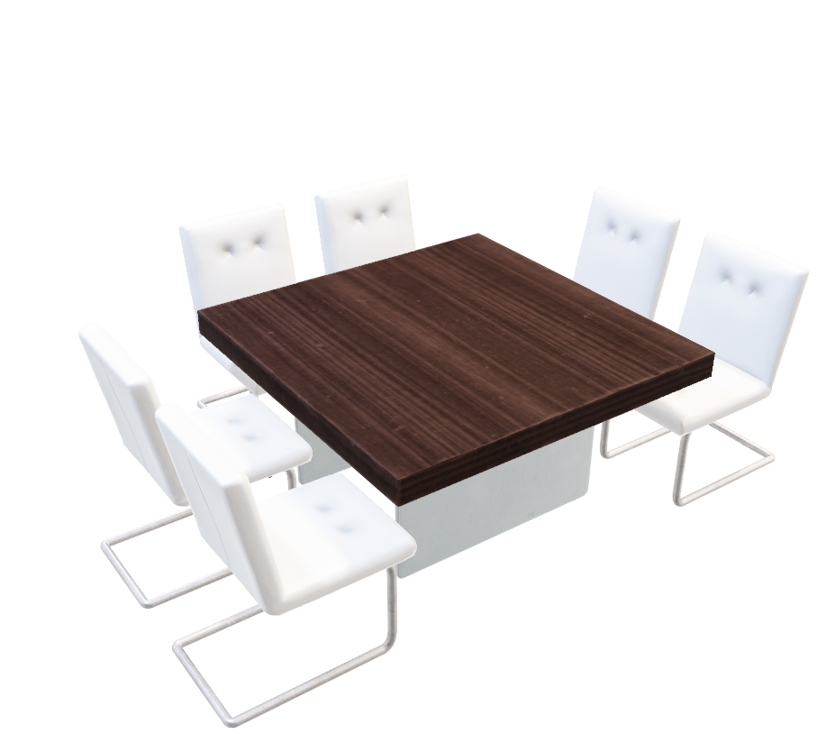
Meal Preparation

Slide 4
Meal Preparation
There are thousands of Meals across the world. But we find it difficult to select one and prepare on every day basis. In general we use data analytics unknowingly in our everyday meal preparation. We can bifurcate data analytics in meal preparation in six steps.
(Plan, Prepare, Process, Analyze, Share, Act)

Slide 5
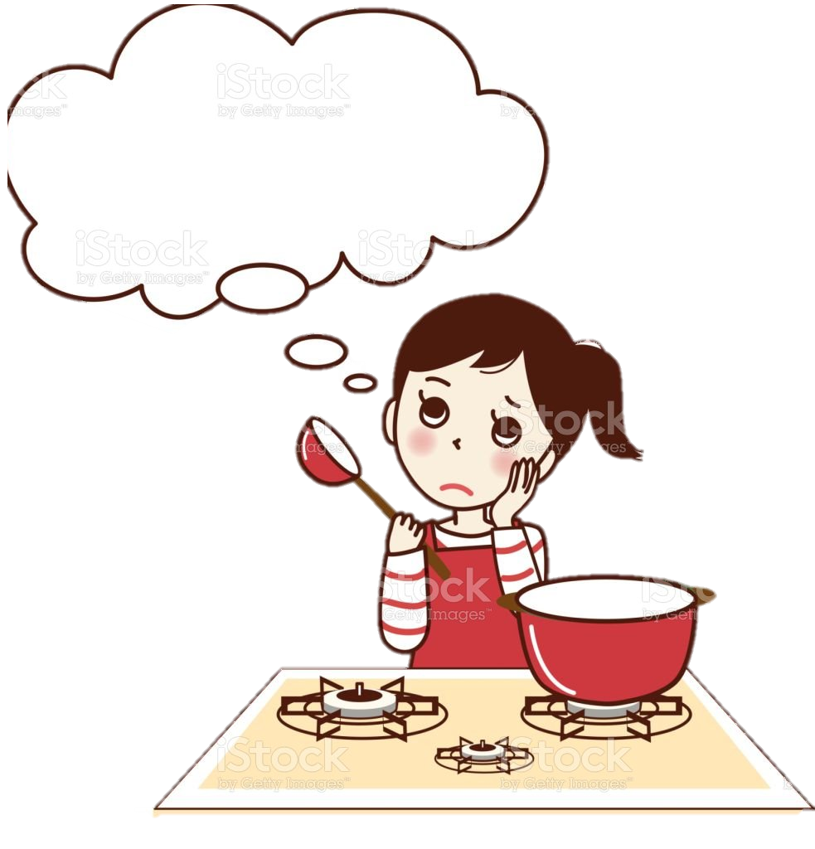
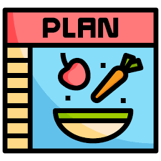
1. Plan:
First step of meal preparation is to plan.
To plan the meal we generally think about the following questions to get data for planning.
Is it for lunch, dinner or breakfast ?
What is the budget for this meal ?
Based on the preferences of family members which kind of cuisines I need to prepare? ( Indian, Chinese, Italian, etc.)
Is there any restriction on meal due to health issue?? (diet, BP issue, diabetes etc)
Based on the answers of the above questions. We decide a meal options from large amount of options.

Slide 6

2. Prepare:
After deciding meal plan, next step is to prepare the necessary items for meal.
For that first we need to check the recipe and make a list of ingredients, appliance. Based on the list we need to check following questions.
Do I have everything from the list in kitchen for preparation of meal
Check pantry (flours, sauces, Spices, vegetables etc.)
Check appliance ( Oven, Sandwich maker, toaster, blender, mixer)
If anything is missing than will I get that from market?
Where can I find these ingredients or appliance ?
What is the budget to purchase the necessary items ? Can I afford it ?
If any of the item listed is not possible to get before meal preparation then revise the plan as per previous step.

Slide 7

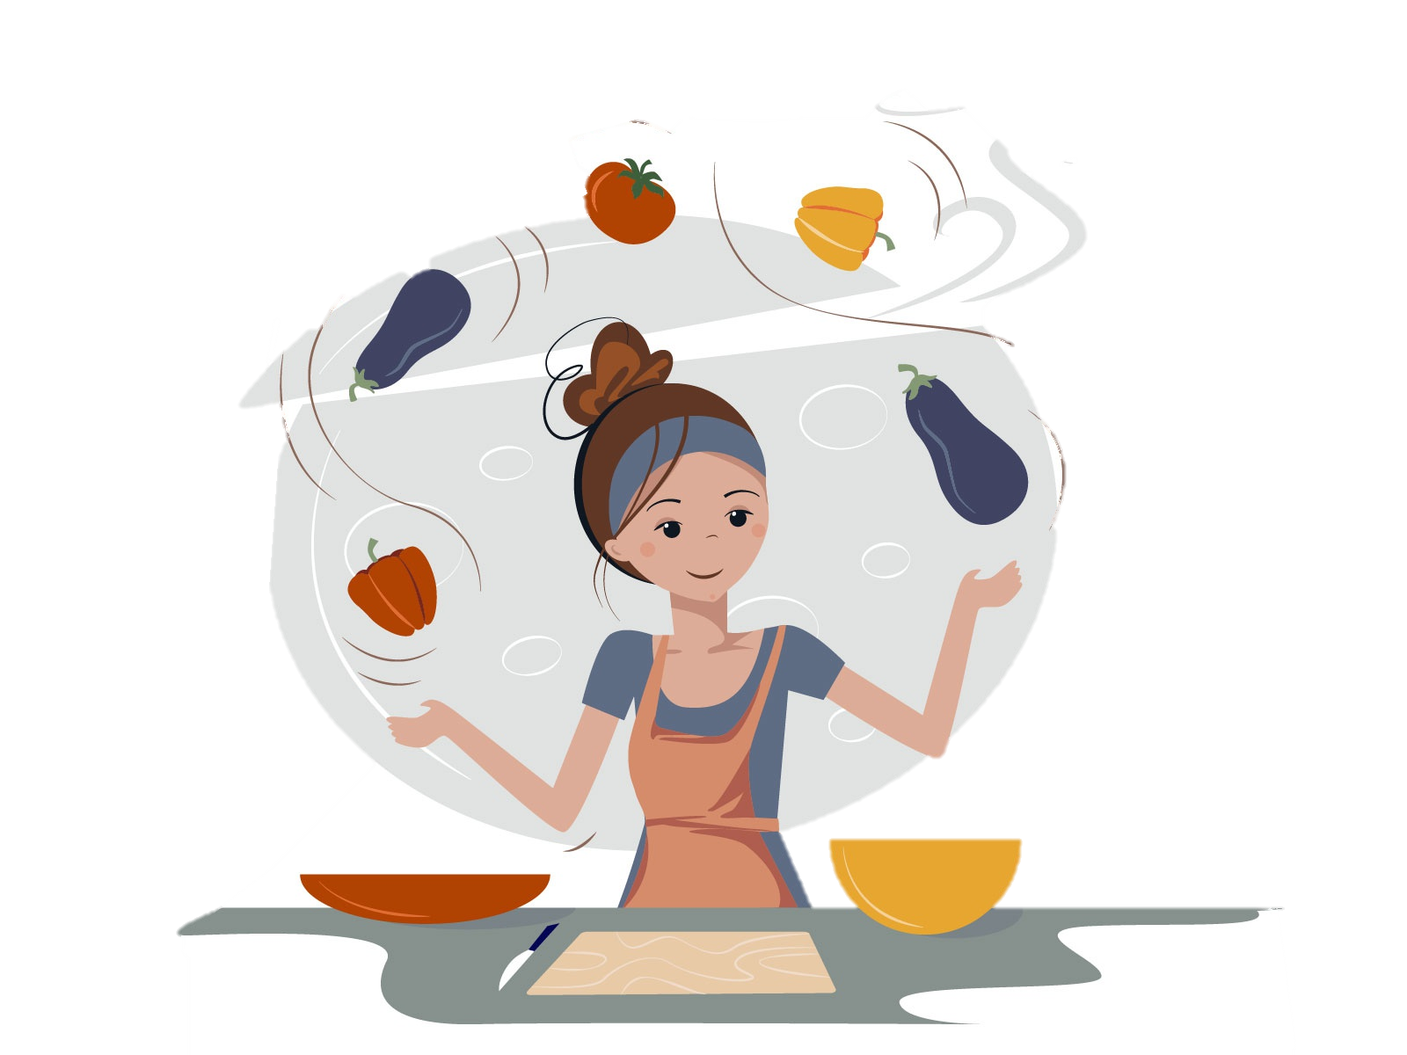
3. Process
Third step is the process. By following steps below, meal can be processed :
Time required to prepare the food
To cook the meal we referred two or more recipes from book or online. We adjust recipes based on previous experience, preferred taste of family members (like, sweetness, saltness and spiciness)
Are there any specific techniques & skills required for cooking? (like, fry, steam, boil, bake etc.)
Follow the preparation step order using cooking skills and standard recipe technique.
If you do not have required specific cooking skills, change the plan for meal preparation and follow step 1.

Slide 8
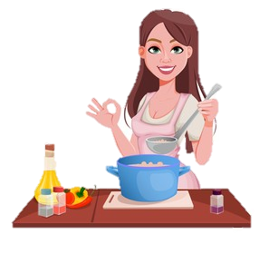
4. Analyze
Fourth step is to analyze the food during cooking. We can use data analytics in this step to optimize the time, taste, etc.
Analysis can be done by asking below questions:
How much time did it take ?
How much did it cost on buying necessary items ?
How does it taste ?
Does any adjustment on recipes required?

Slide 9
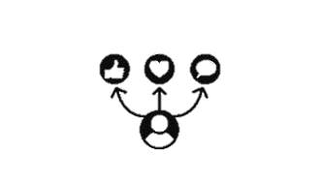
5. Share
Fifth step is to share the cooked food to family members, and share recipes plan with others or to social media and get feedback.
How can I garnish my cooked food for more visually appealing?
This step will focus on feedback from those who ate the meal so that taste and satisfaction of food can be improved next time.

Slide 10

6. Act
Last step is to act.
In this step, consider the all feedback gained in last stage, adjust the meal plan, dietary and cooking process for future meal preparation.

Slide 11
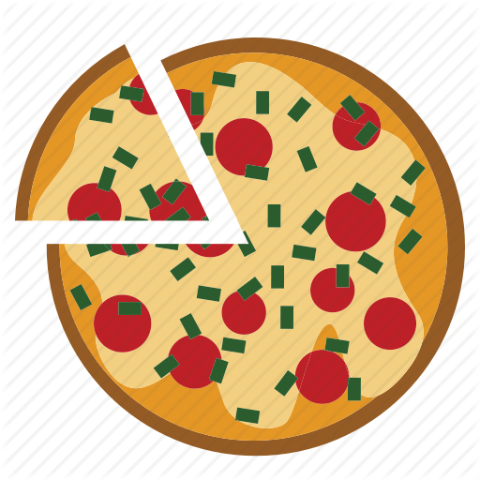
Case study : Meal preparation
Pizza
1. Plan :
Is it for lunch, dinner or breakfast ? ( Ans. : It is for dinner)
What is the budget for this meal ? ( Ans. : Approx. 200 Rs. per person)
Based on the preferences of family members which kind of cuisines I need to prepare? ( Ans. : Italian)
Is there any restriction on meal due to health issue?? (Ans. : Not too spicy)
2. Prepare :
Check pantry & appliance (Ans. I have all ingredients except pizza bread, spices, and oven)
If anything is missing than will I get that from market? (Ans. : We need to buy pizza bread from local market.)

Slide 12
Case study : Meal preparation
Pizza
3. Process :
Time required to prepare the cook (2 hours)
Are there any specific techniques for cooking? ( Ans.: Bake)
Follow the recipe process for making pizza from any food website or book.
4. Analyze :
How much time did it take ? (1.5 hours)
How much did it cost on buying necessary items ? (Approx. : 300 Rs. for 2 person)
How does it taste ? ( Little bit spicy than expectation)
Does any adjustment on recipes required? (Yes, Use less chilly powder)

Slide 13
Case study : Meal preparation
Pizza
5. Share :
Take feedback from those who ate the meal so that taste and satisfaction of food can be improved next time. (Feedback : Little bit spicy & less cheesy)
6. Act :
Considering two feedback from last step i.e., Little bit spicy & less cheesy, need to adjust the amount of chilly and cheese for the next pizza preparation.

